Slide 1
CUDA Advanced Libraries
cuFFT Performance and Features

Slide 2
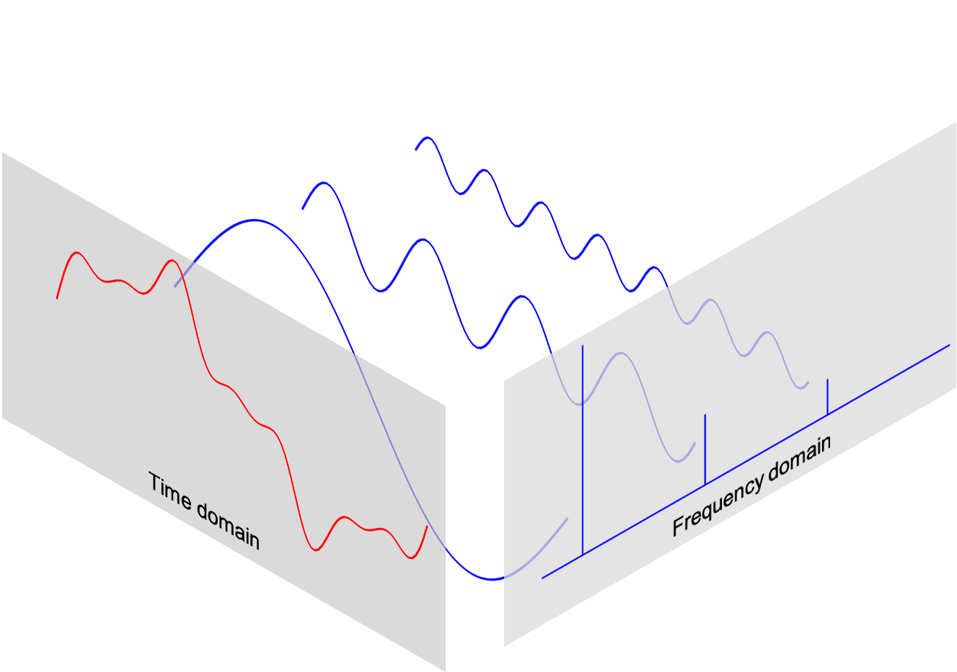
What is a FFT?
Fast Fourier Transforms are a method to solve a sequence of Discrete Fourier Transforms.
A DFT is a method for taking a signal in the time domain and converting it into a collection of waves in the frequency domain.
It was formalized by Tukey in 1965 but Gauss had identified them.
[1]

Slide 3
Why does This Matter?
Calculus is tough and this helps with complex derivations, etc.
This process is way more efficient than other methods. FFTs are O(n log n) and other methods are generally O (n²)
This may seem minor but when you are using this on continuous data streams, it makes it possible for doing real-time signal processing.

Slide 4
CPU FFTs vs cuFFT
Same story different problem, if you can calculate in parallel GPUs are often better.
Given that FFTs are about decomposing a problem into a sequence of smaller problems, it is a perfect fit for GPUs
GPU processing in general is built to handle continuous data…oh yeah they are video cards!
NVIDIA purports that cuFFTs are 10x faster than CPU implementations.

Slide 5
cuFFT Features
Single to three-dimensional Transforms
Multi GPU support
Real and complex Transforms (C2R, C2C, R2C)
Batch, streaming, and asynchronous processing
Packaged along with rest of NVIDIA Developer Toolkit

Slide 6
References
[1] 2020. Kong, Siauw, and Bayen. Python Programming And Numerical Methods: A Guide For Engineers And Scientists.
[2] 2021. NVIDIA. Fast Fourier Transforms for NVIDIA GPU Devices. Found at https://developer.nvidia.com/cufft.

